Slide 1
Data science and machine learning
An introduction

Slide 2
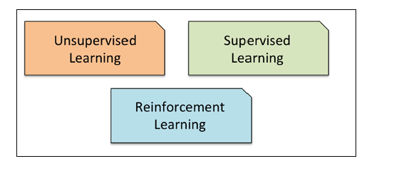
Learning types

Slide 3
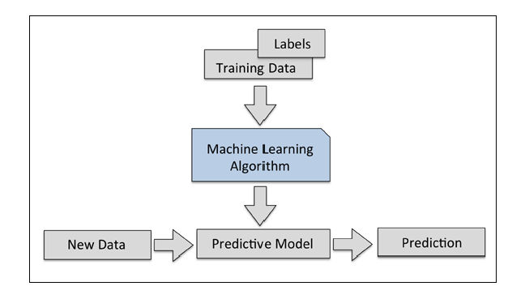
Predicting

Slide 4
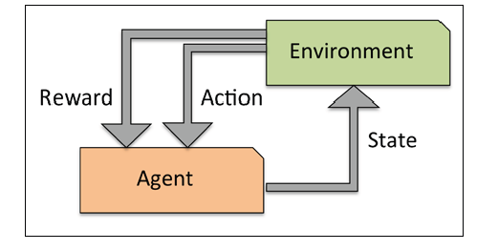
Reinforcement learning

Slide 5
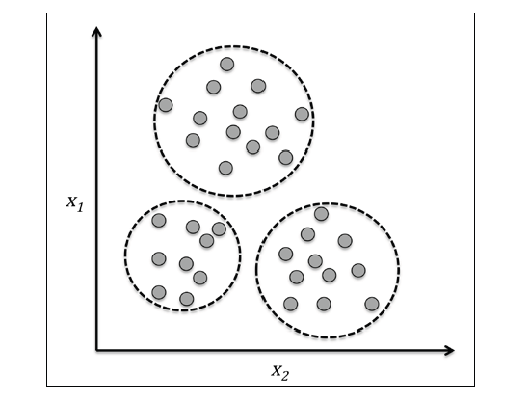
clustering

Slide 6
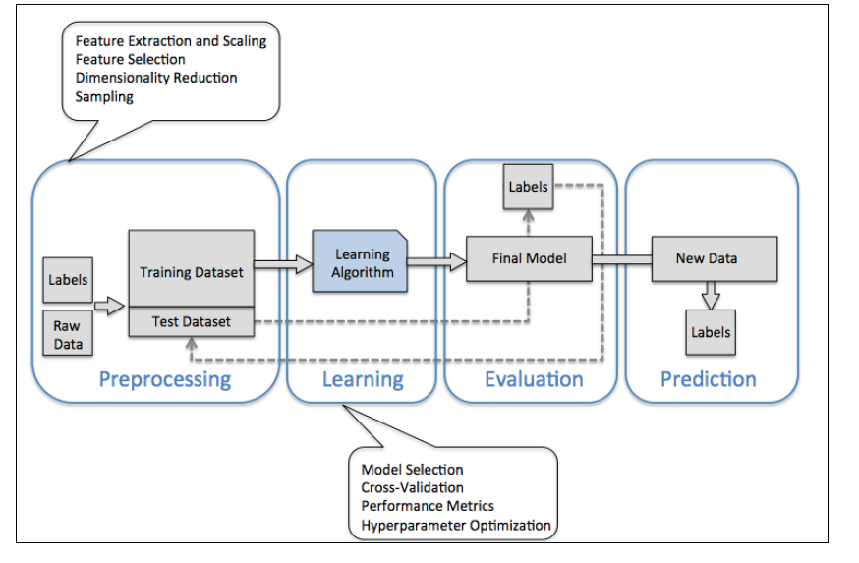
What is a machine learning system

Slide 7
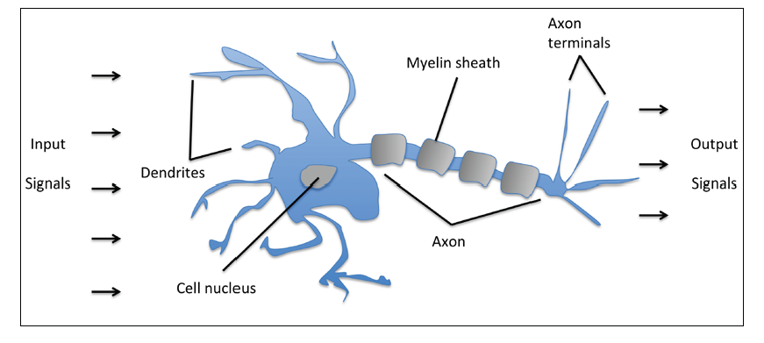
Neurons – a start

Slide 8
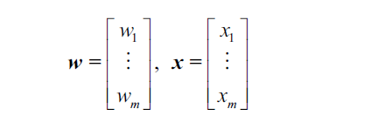
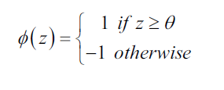
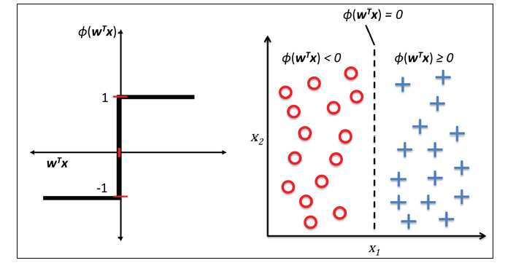
perceptron

Slide 9

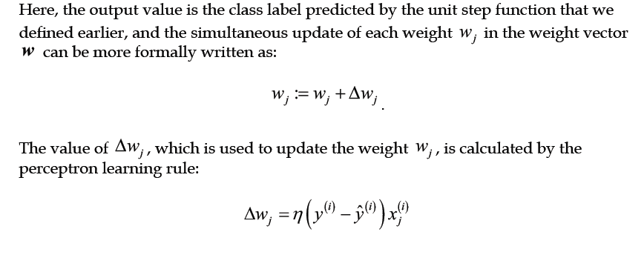
algorithm

Slide 10
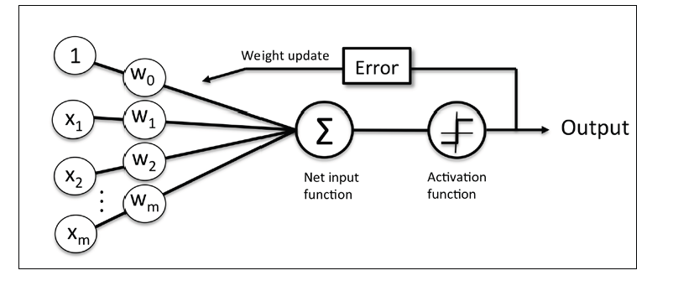
Perceptron-summary

Slide 11

Types of data

Slide 12




Perceptron in scikit-learn

Slide 13
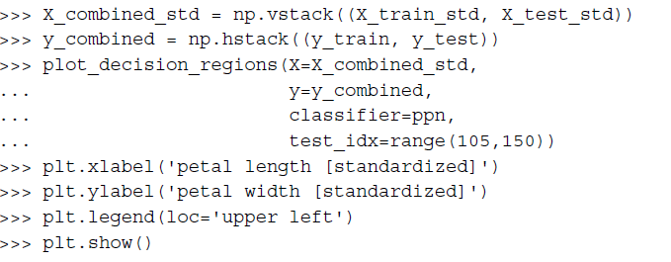
Perceptron in scikit-learn - continued

Slide 14
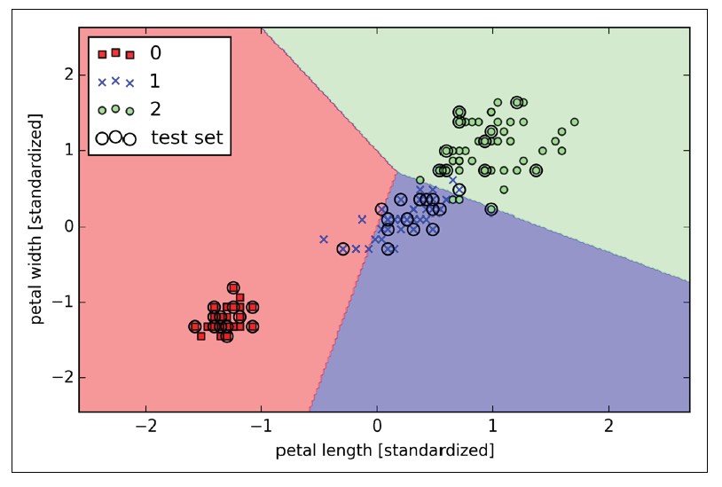
Perceptron in scikit-learn - continued

Slide 15
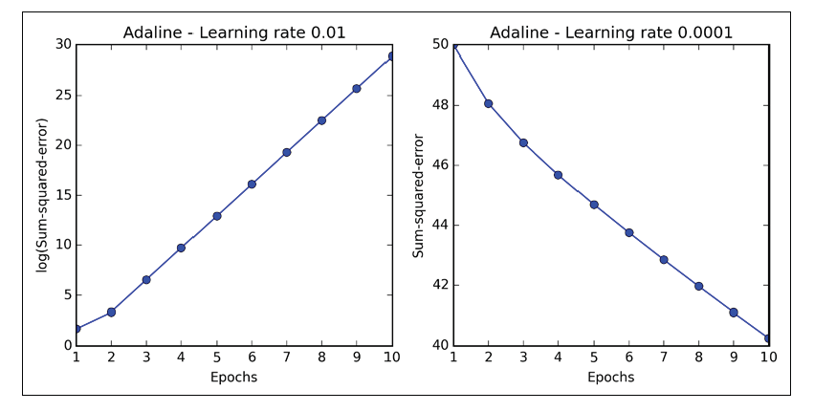
Model performance

Slide 16
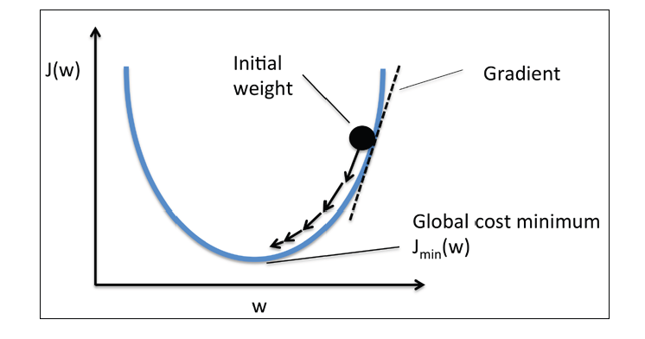
Gradient descent

Slide 17
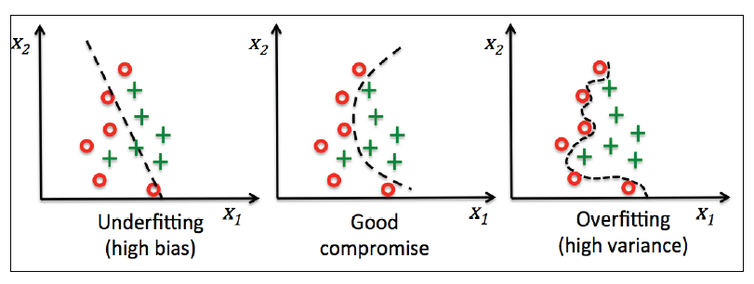
Bias and variance

Slide 18


Linear regression

Slide 19
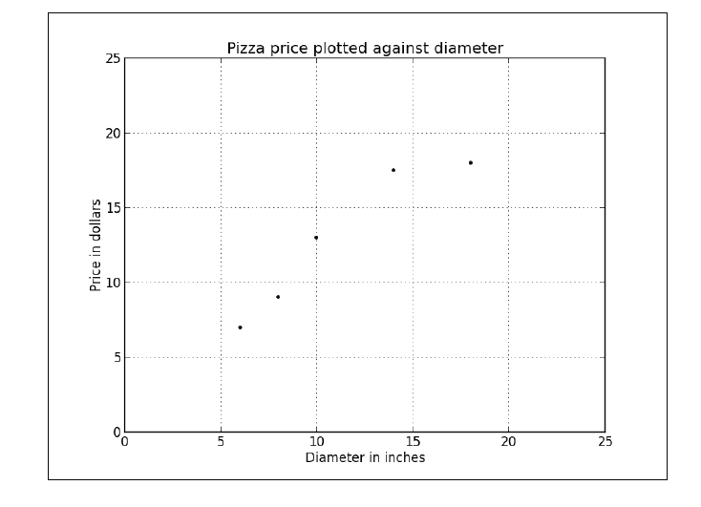
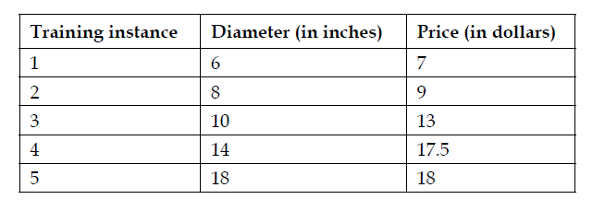
Linear regression

Slide 20
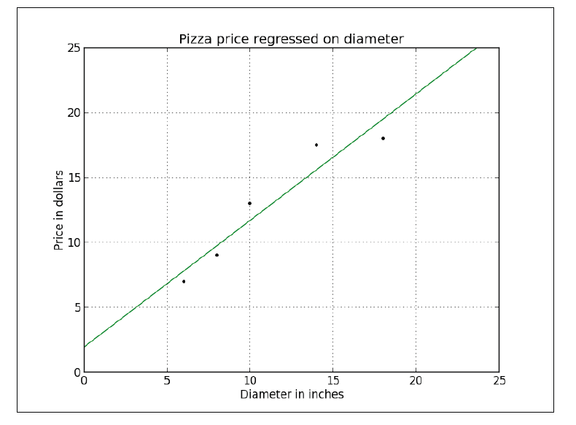

Linear regression

Slide 21
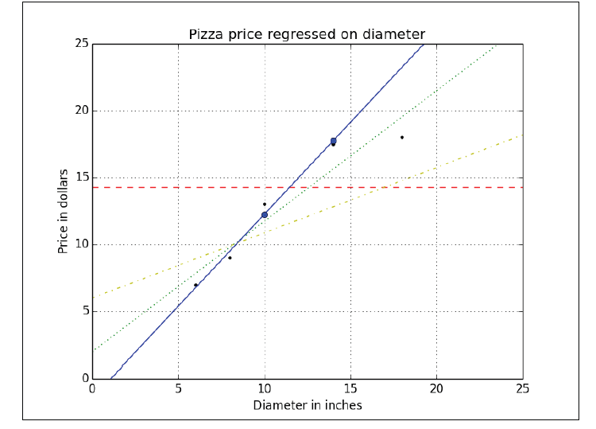
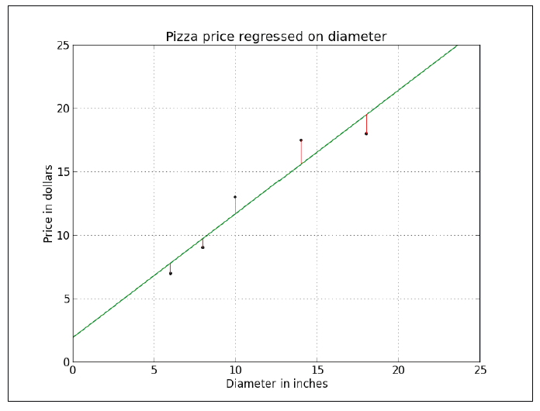
Linear regression – cost function

Slide 22


Linear regression – cost function

Slide 23
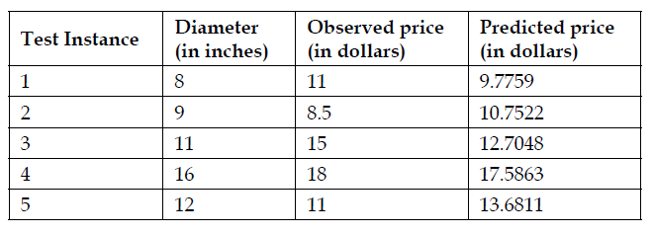



Linear regression – model evaluation

Slide 24
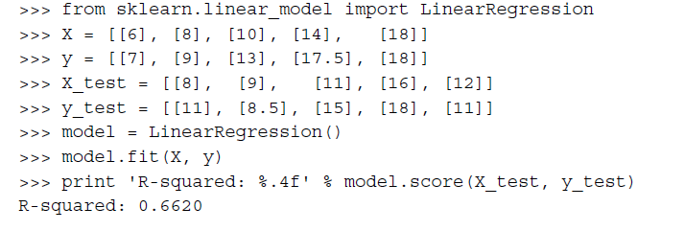
Linear regression

Slide 25

Multiple linear regression

Slide 26
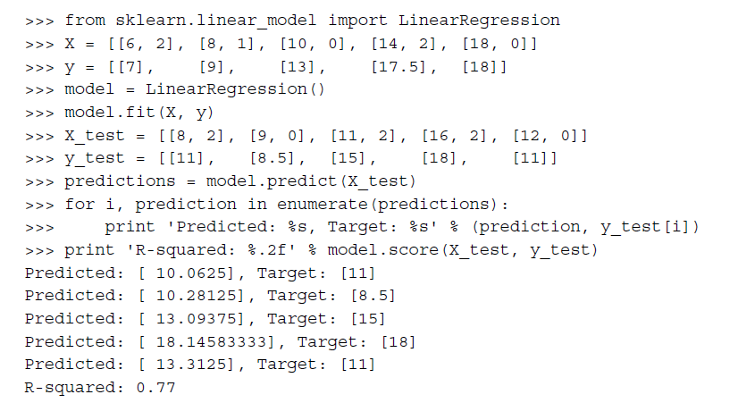
Multiple linear regression

Slide 27
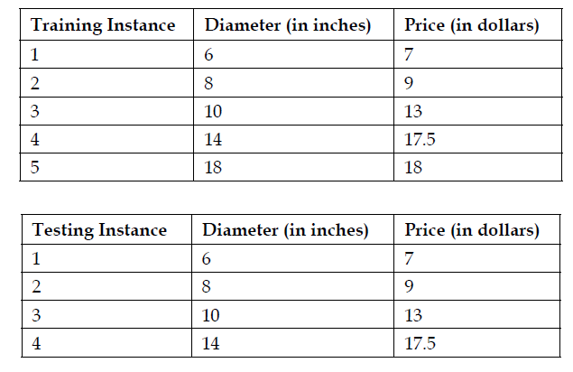
Polynomial regression

Slide 28

Polynomial regression

Slide 29

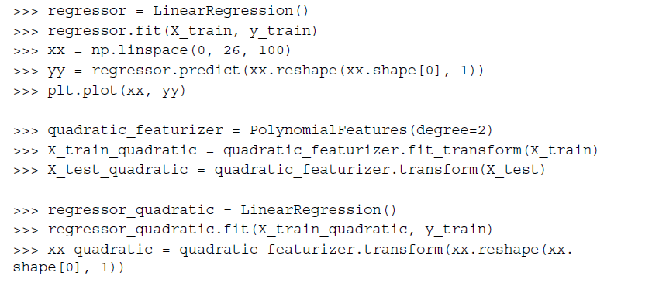
Polynomial regression

Slide 30
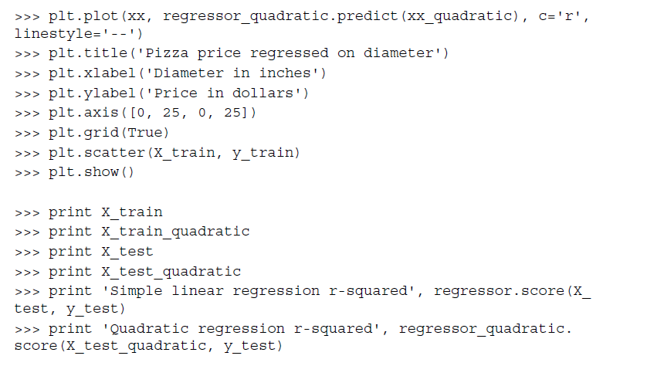
Polynomial regression

Slide 31
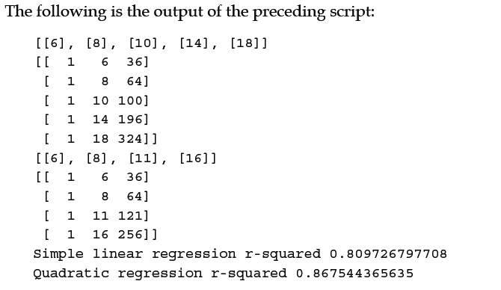
Polynomial regression

Slide 32
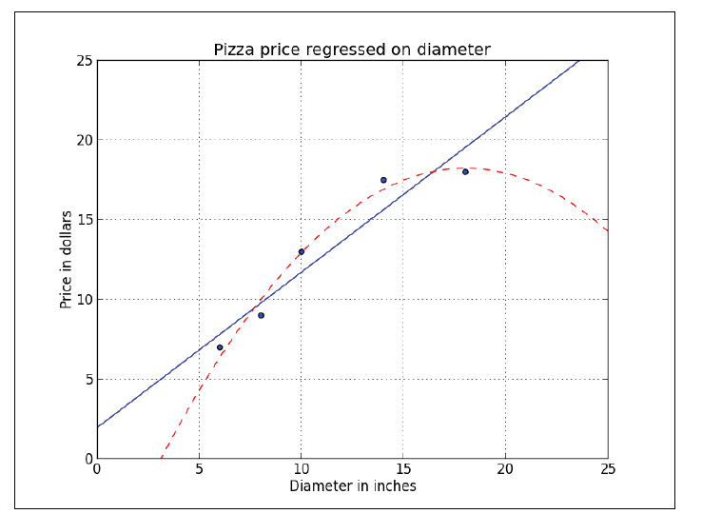
Polynomial regression

Slide 33

Linear regression - example
https://archive.ics.uci.edu/ml/datasets/Wine

Slide 34
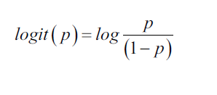

LOGISTIC REGression

Slide 35
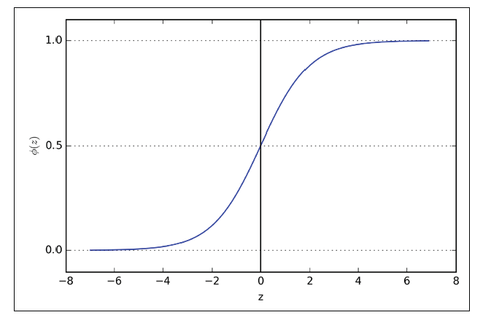
Logistic regression

Slide 36
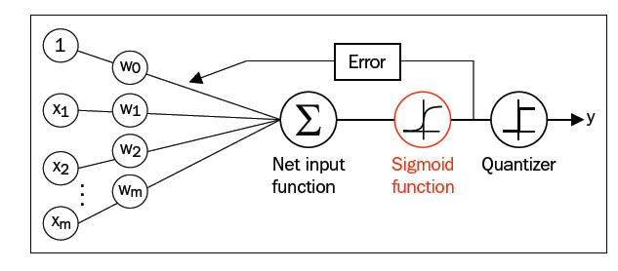
Logistic regression

Slide 37
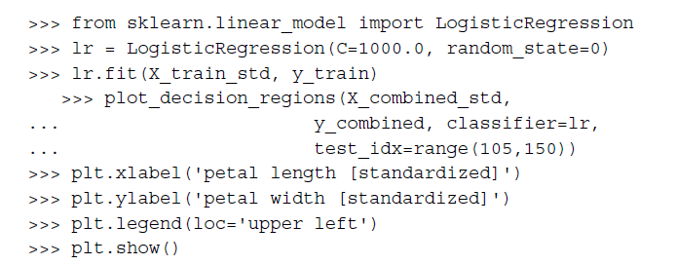
Logistic regression

Slide 38
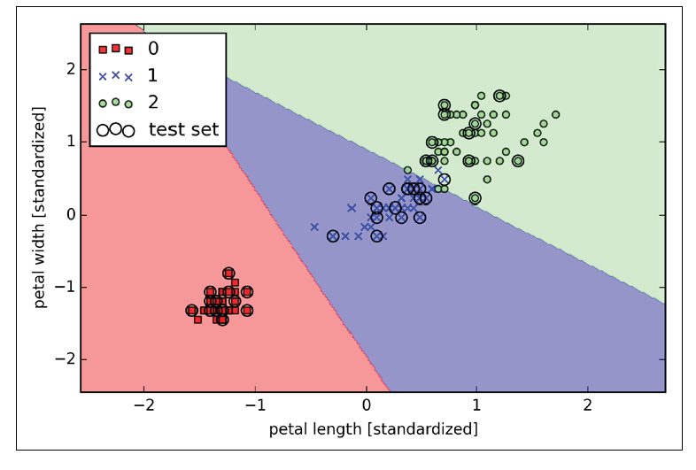
Logistic regression

Slide 39

Feature extraction

Slide 40

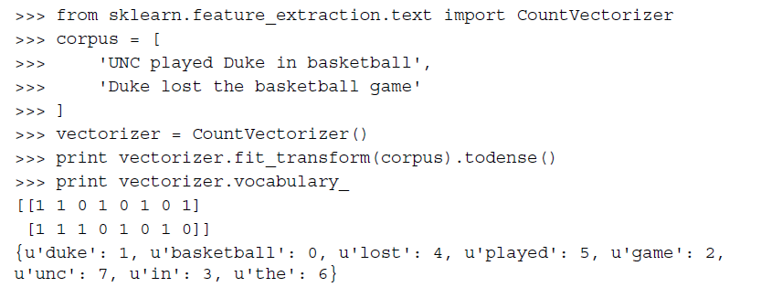
Bag-of-words

Slide 41

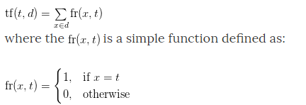
TF-IDF

Slide 42
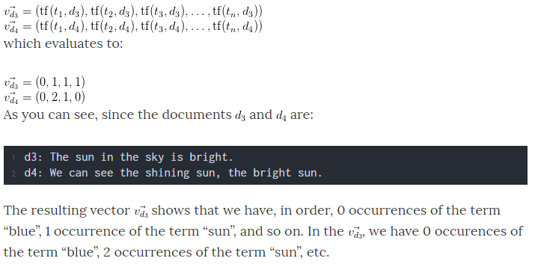
Tf-idf

Slide 43
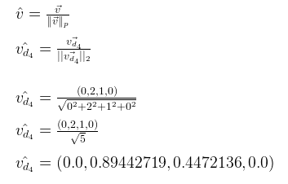
Tf-idf

Slide 44


Tf-idf

Slide 45
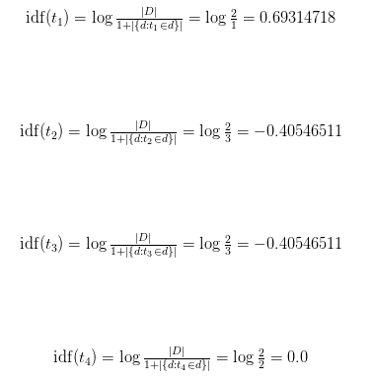
Tf-idf

Slide 46
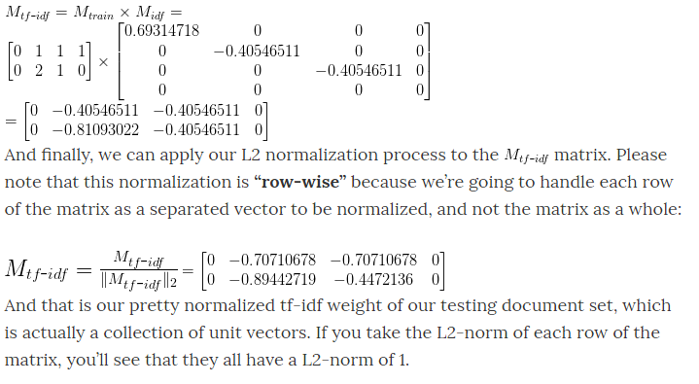
Tf-idf

Slide 47


Tf-idf

Slide 48

Tf-idf

Slide 49
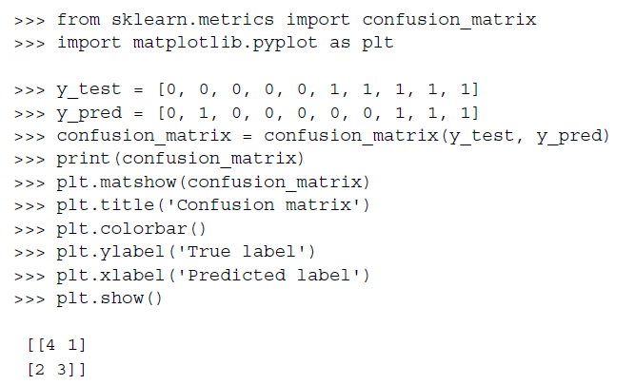
metrics

Slide 50
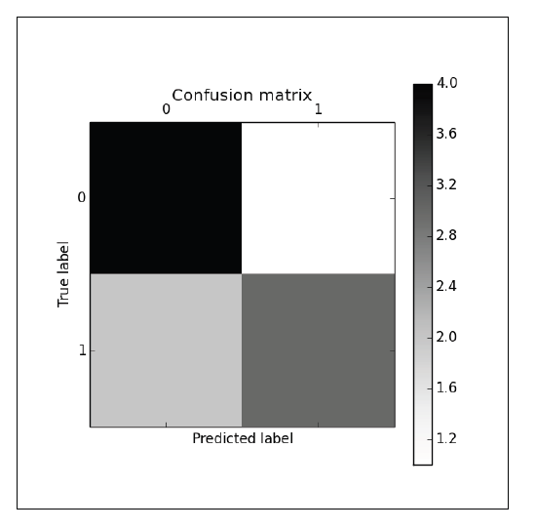
metrics

Slide 51



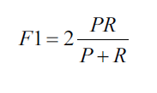
metrics

Slide 52
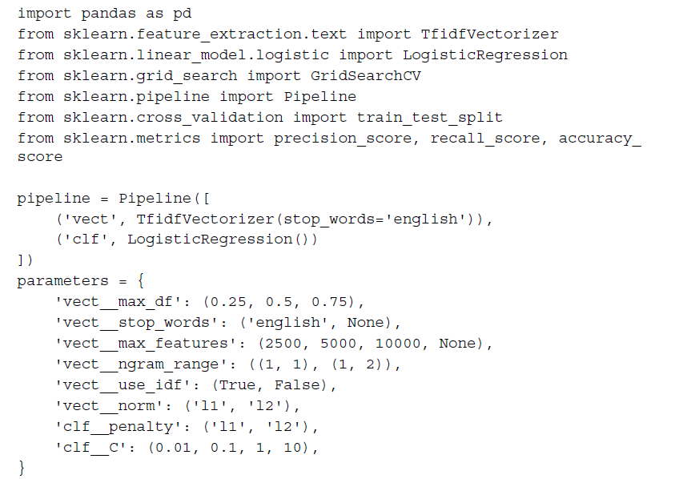
pipelines

Slide 53
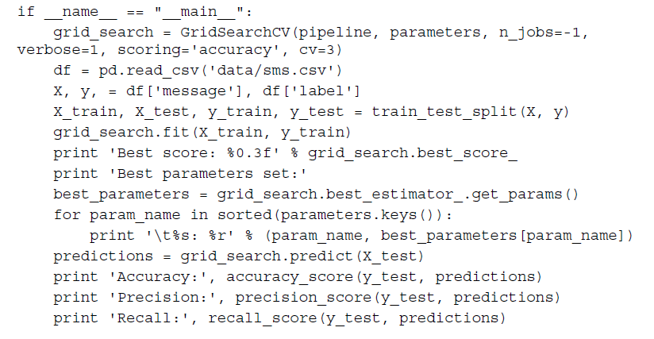
pipelines

